Slide 1


CSE-213
(Data Structure)
Lecture on
Chapter-4: LINKED LISTS
Department of Computer Science & Engineering (CSE)
City University, Khagan, Birulia, Savar, Dhaka-1216, Bangladesh

Slide 2
LINKED LISTS:
Start
Pointer
List
Link
8
NAYEM
MOHIUDDIN
THAMINA
JALAL
JIHAD
RAIHAN
TOKIA
ABDULLAH
6
1
7
5
2
3
0
4
1
2
3
4
5
6
7
8
LINKED LIST

Slide 3
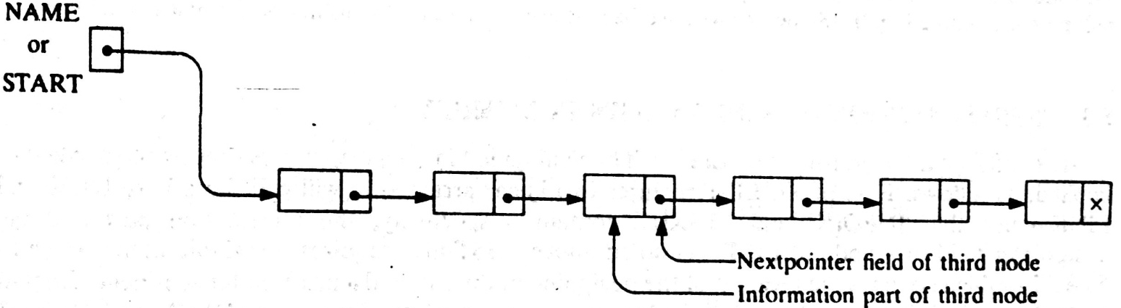
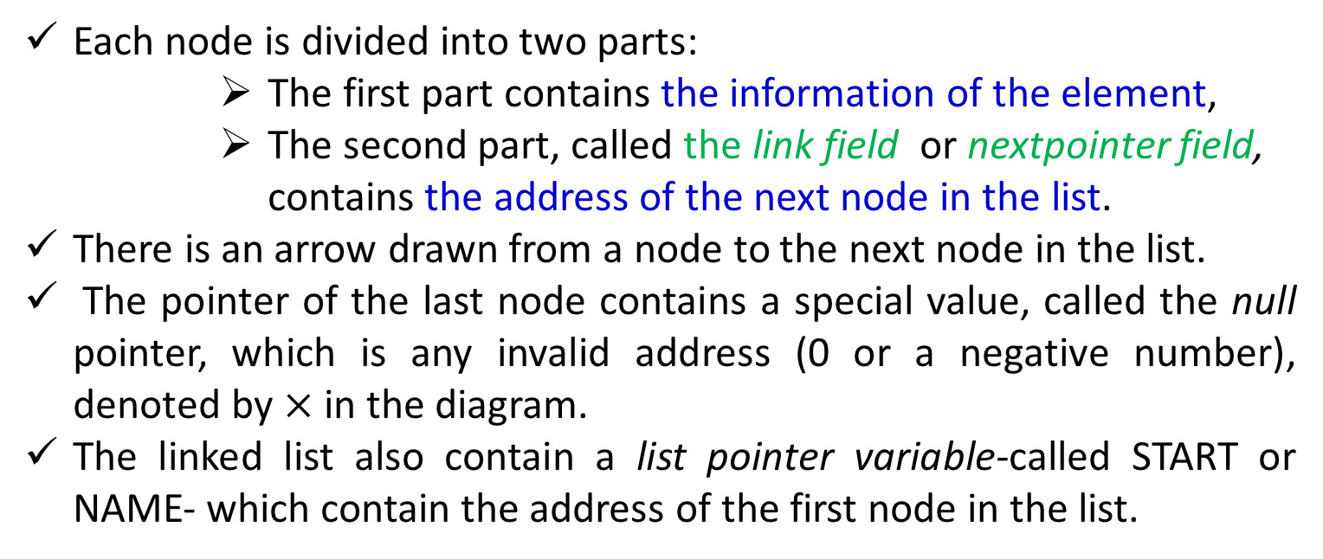
LINKED LISTS: Definition
A linked list, or one-way list, is a linear collection of data elements, called nodes, where the linear order is given by means of pointers.
Each node is divided into two parts:
The first part contains the information of the element,
The second part, called the link field or nextpointer field, contains the address of the next node in the list.
There is an arrow drawn from a node to the next node in the list.
The pointer of the last node contains a special value, called the null pointer, which is any invalid address (0 or a negative number), denoted by $×$ in the diagram.
The linked list also contain a list pointer variable-called START or NAME- which contain the address of the first node in the list.
Notes:
There is an arrow drawn from START to the first node. Clearly, we need only this address in START to trace through the list. A special case is the list that has no node . Such a list called the null list or empty list and is denoted by null pointer in the variable START.

Slide 4
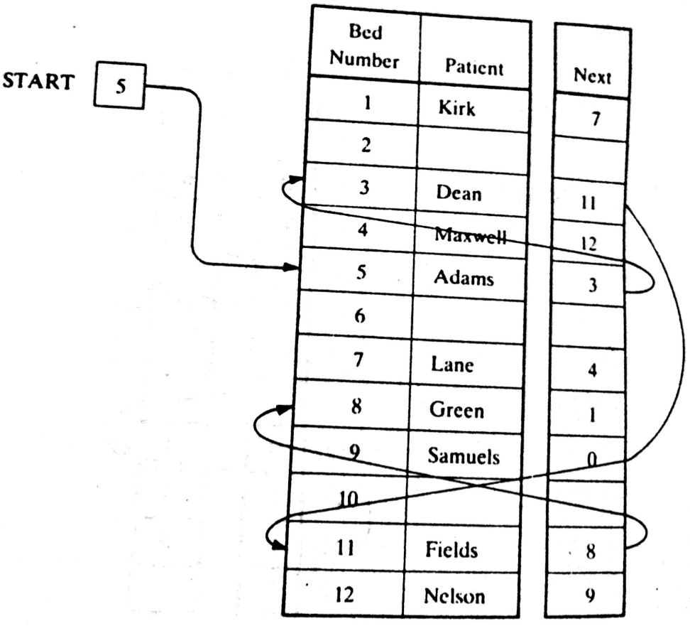
LINKED LISTS: Example

Slide 5
LINKED LISTS: Representation in Memory
Let LIST be a linked list which will be maintained in the memory
LIST requires…..
Two linear array,
INFO[K]-Information part, and
LINK[K]-nextpointer field of a node of LIST
A variable name-START, indicating the beginning of the LIST.
A nextpointer senitel-NULL, indicates the end of the LIST
Since, the subscripts of the array INFO and LINK will usually be positive, NULL=0, unless otherwise stated

Slide 6
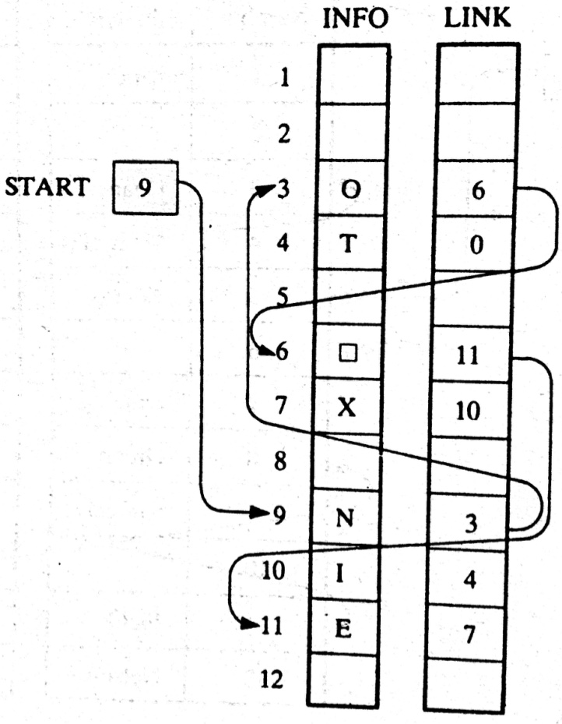
LINKED LISTS: Example
START=9, so INFO[9]= ?
LINK[9]=3, so, INFO[3]=?
LINK[3]=6, so, INFO[6]=?
LINK[6]=11, so, INFO[11]=?
LINK[11]=7, so, INFO[7]= ?
LINK[7]=10, so, INFO[10]= ?
LINK[10]=4, so, INFO[4]= ?
LINK[4]=0, so, INFO[0]= ?
N
0
⎕
E
X
I
T
NULL

Slide 7
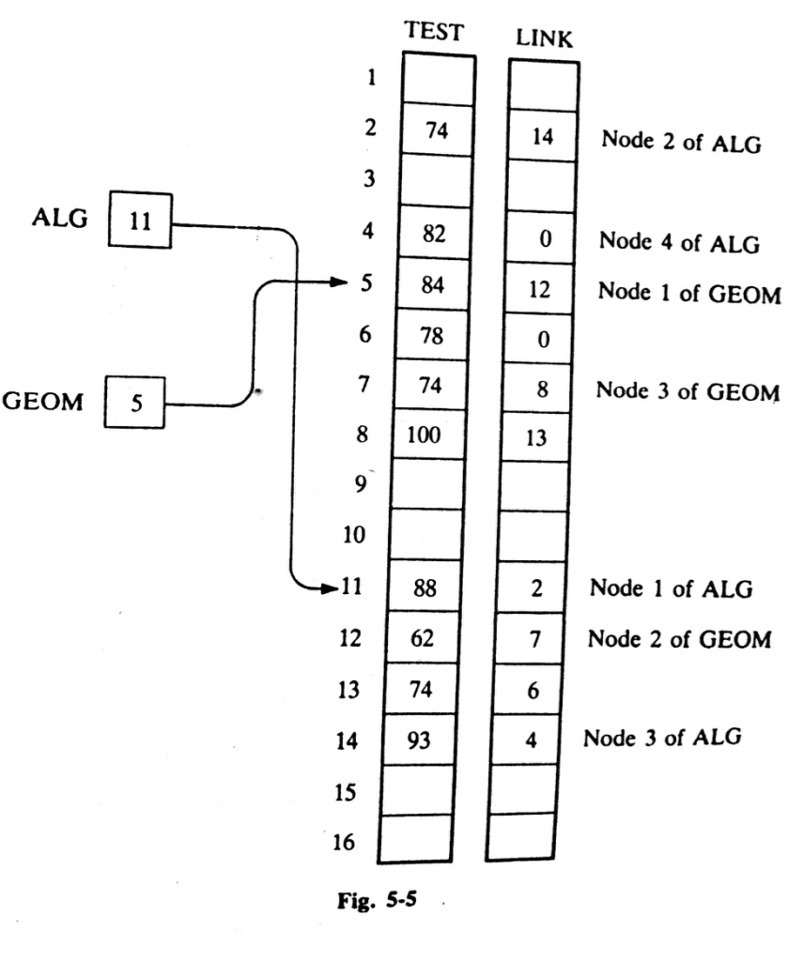
LINKED LISTS: Example
ALG consists of Test score:
88, 74, 93, 82
GEOM consists of Test score:
84, 62, 74, 100,74, 78

Slide 8
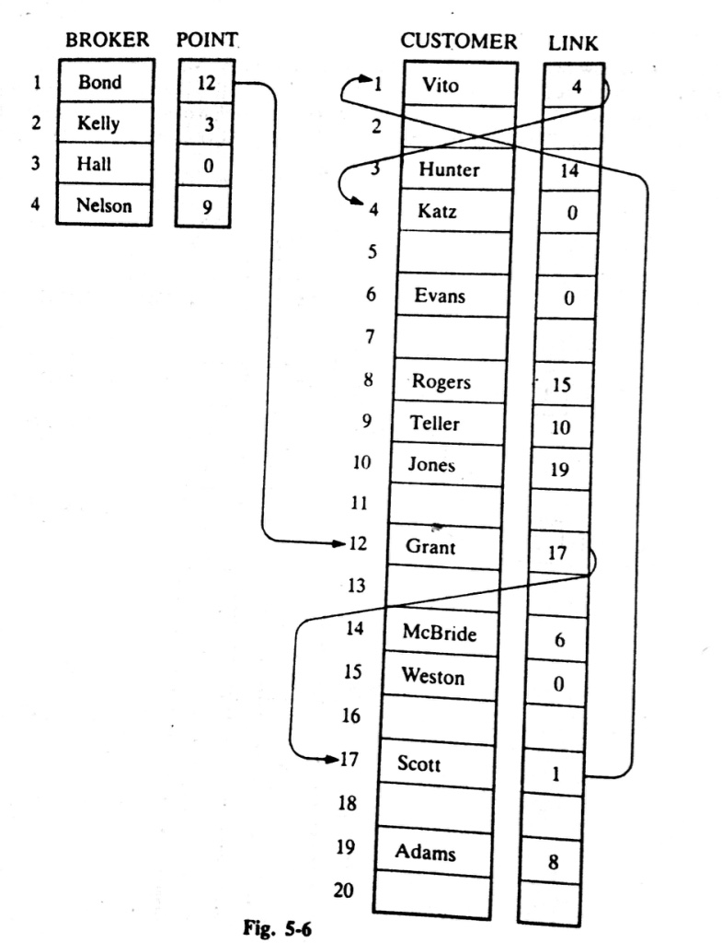
LINKED LISTS: Example
Bond’s list of customers:
Grant, Scott, Vito, Katz
Kelly’s list of customers:
Hunter, McBridge, Evans
Hall’s list of customers:
NULL / Empty List
Nelson’s list of customers:
Teller, Jones, Adams, Rogers, Weston

Slide 9
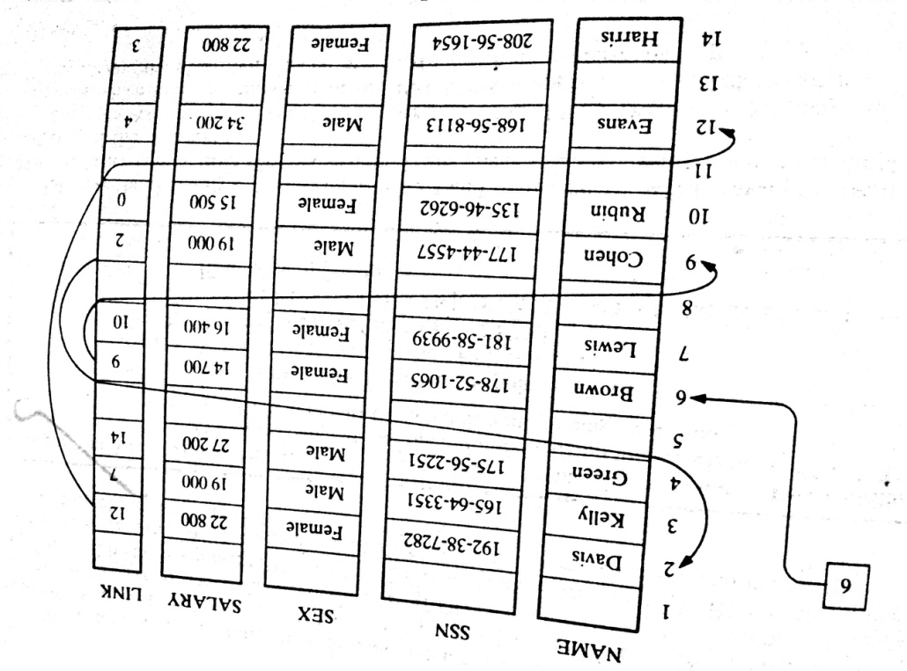
LINKED LISTS: Example
In general, the information part of a node may be a record with more than one data item.
In such a case, the data must be stored in some type of record structure or in a collection of parallel arrays.

Slide 10
LINKED LISTS: Types
The following are the types of linked list:
Singly Linked list
Doubly Linked list
Circular Linked list
Doubly Circular Linked list

Slide 11
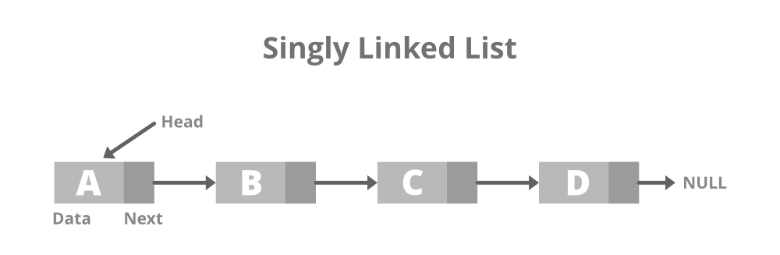
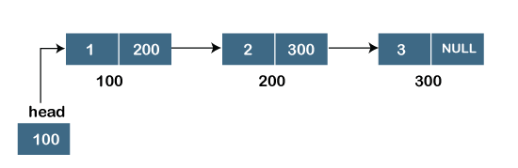
LINKED LISTS: Types
1. Singly Linked List
It is the simplest type of linked list in which every node contains some data and a pointer to the next node of the same data type.
The node contains a pointer to the next node means that the node stores the address of the next node in the sequence.
A single linked list allows the traversal of data only in one way. Below is the image for the same:

Slide 12
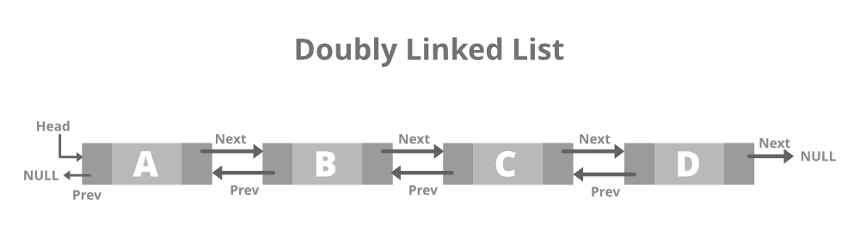
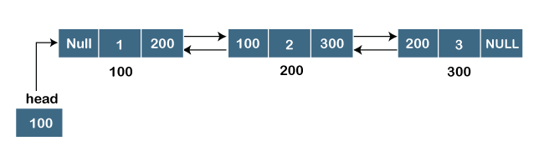
LINKED LISTS: Types
2. Doubly Linked list
A doubly linked list or a two-way linked list is a more complex type of linked list that contains a pointer to the next as well as the previous node in sequence.
Therefore, it contains three parts of data, a pointer to the next node, and a pointer to the previous node. This would enable us to traverse the list in the backward direction as well. Below is the image for the same:

Slide 13
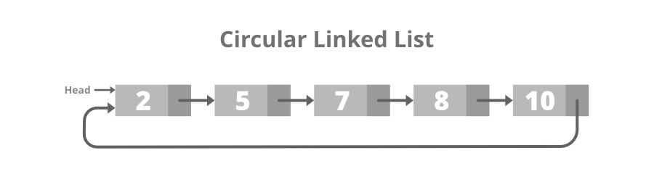
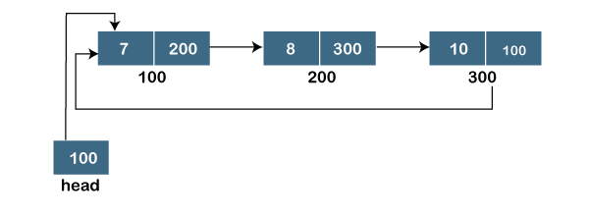
LINKED LISTS: Types
3. Circular Linked List
A circular linked list is that in which the last node contains the pointer to the first node of the list.
While traversing a circular linked list, we can begin at any node and traverse the list in any direction forward and backward until we reach the same node we started. Thus, a circular linked list has no beginning and no end. Below is the image for the same:

Slide 14
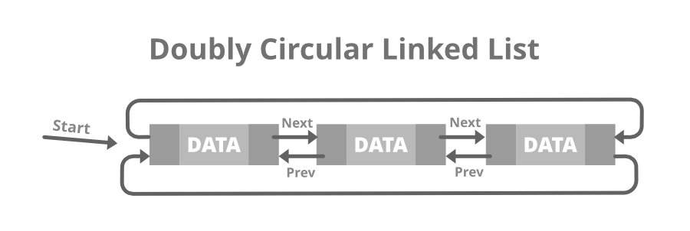
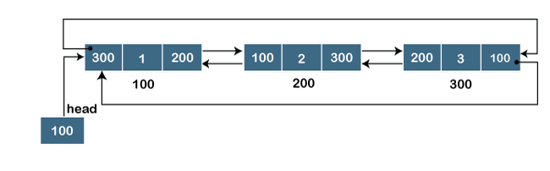
LINKED LISTS: Types
4. Doubly Circular linked list
A Doubly Circular linked list or a circular two-way linked list is a more complex type of linked list that contains a pointer to the next as well as the previous node in the sequence. The difference between the doubly linked and circular doubly list is the same as that between a singly linked list and a circular linked list. The circular doubly linked list does not contain null in the previous field of the first node. Below is the image for the same:

Slide 15
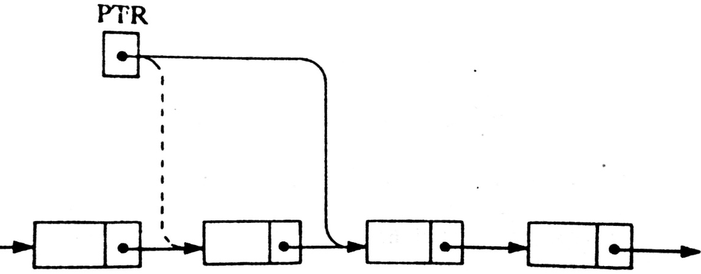
LINKED LISTS: Traversing
Let LIST be a linked list in memory stored in linear arrays INFO and LINK with START pointing to the first element and NULL indicating the end of LIST.
Traversing algorithm uses a pointer variable PTR which points to the node that is currently being processed.
Accordingly, LINK[PTR] points to the next node to be processed. Thus,
PTR:=LINK[PTR], moves the pointer to the next node in the list.

Slide 16
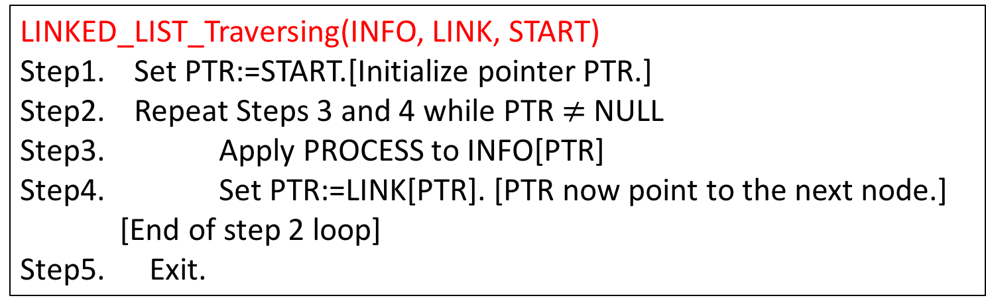
LINKED LISTS: Traversing Algorithm
Let LIST be a linked list in memory.
LINKED_LIST_Traversing(INFO, LINK, START)
Step1. Set PTR:=START.[Initialize pointer PTR.]
Step2. Repeat Steps 3 and 4 while PTR$≠$ NULL
Step3. Apply PROCESS to INFO[PTR]
Step4. Set PTR:=LINK[PTR]. [PTR now point to the next node.]
[End of step 2 loop]
Step5. Exit.
Any difference with Linear array traversing ??
LINEAR_ARRAY_Traversing
Step 1. [Initialize counter] Set K:=LB
Step 2. Repeat Step 3 and 4 while K<=UB [Repeat while loop]
Step 3. [Visit element] Apply PROCESS to A[K].
Step 4. [Increase counter] Set K:=K+1.
[End of Step 2 loop.]
Step 5. Exit.

Slide 17
LINKED LISTS: Practice…
Teach yourself: Example 5.7 (Find the number of elements in a linked list)

Slide 18
LINKED LISTS: Searching
Given:
LIST- a linked list in memory (Unknown/Unseen)
ITEM- a specific information.
Objective: Finding the location LOC of the node where ITEM first
appears in LIST.
Here, TWO searching algorithm will be discussed for finding the location of LOC of the node where ITEM first appears in LIST.
Algorithm-1 for LIST is Unsorted
Algorithm-2 for LIST is Sorted.

Slide 19
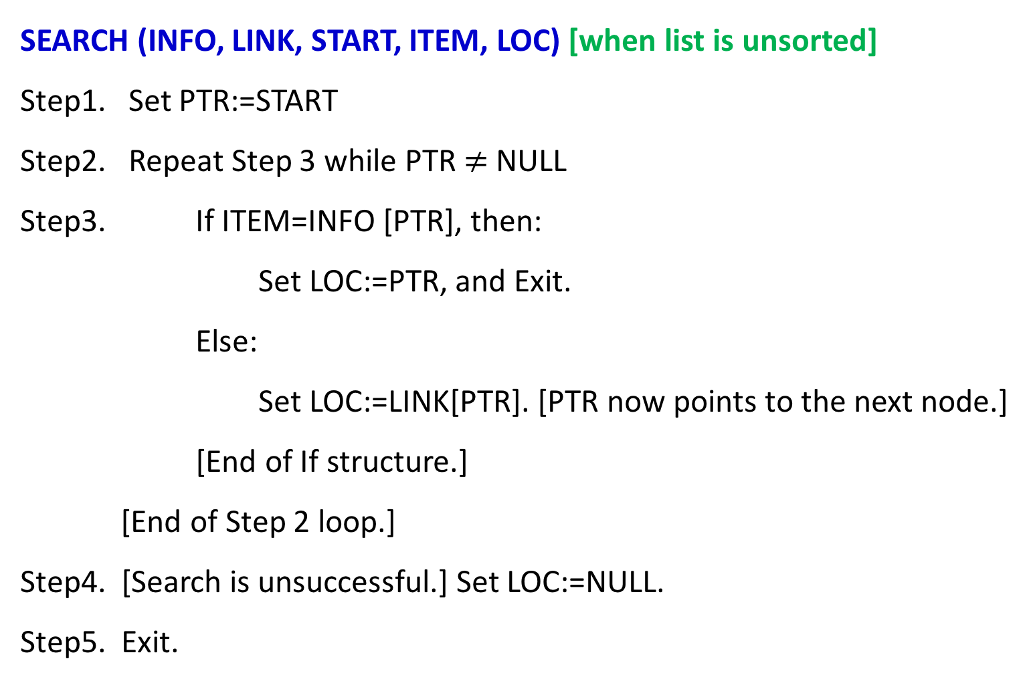
LINKED LISTS: Searching Algorithm-1
SEARCH (INFO, LINK, START, ITEM, LOC) [when list is unsorted]
Step1. Set PTR:=START
Step2. Repeat Step 3 while PTR $≠$ NULL
Step3. If ITEM=INFO [PTR], then:
Set LOC:=PTR, and Exit.
Else:
Set LOC:=LINK[PTR]. [PTR now points to the next node.]
[End of If structure.]
[End of Step 2 loop.]
Step4. [Search is unsuccessful.] Set LOC:=NULL.
Step5. Exit.

Slide 20
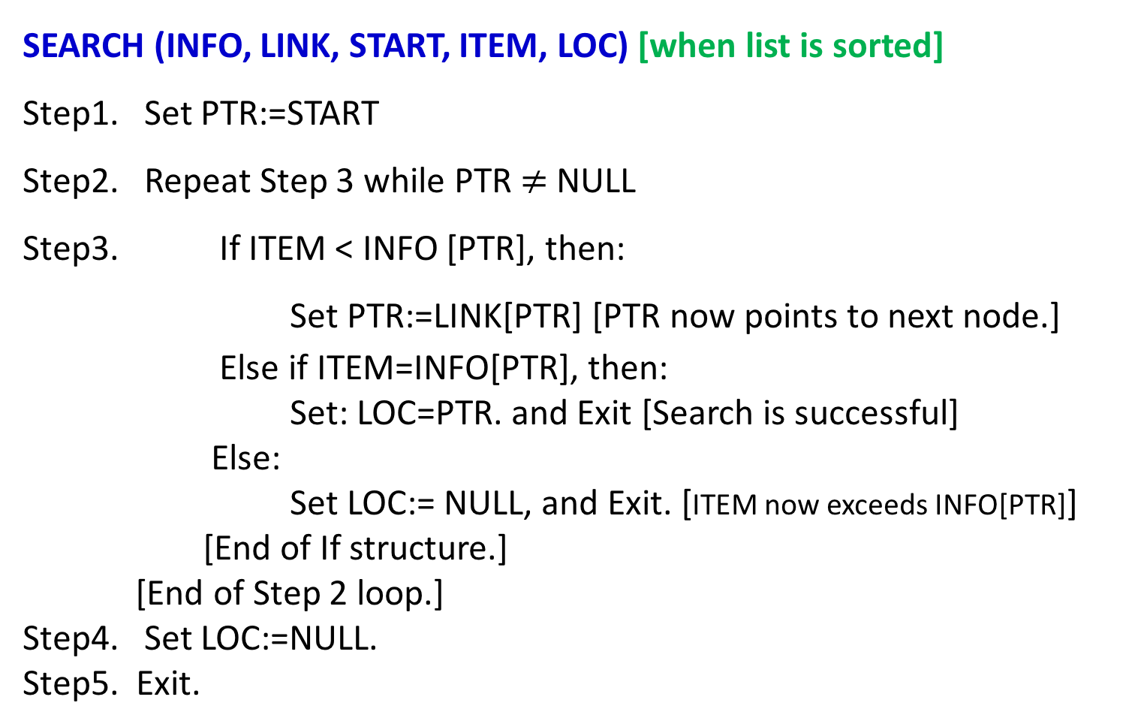
LINKED LISTS: Searching Algorithm-2
SEARCH (INFO, LINK, START, ITEM, LOC) [when list is sorted]
Step1. Set PTR:=START
Step2. Repeat Step 3 while PTR $≠$ NULL
Step3. If ITEM < INFO [PTR], then:
Set PTR:=LINK[PTR] [PTR now points to next node.]
Else if ITEM=INFO[PTR], then:
Set: LOC=PTR. and Exit [Search is successful]
Else:
Set LOC:= NULL, and Exit. [ITEM now exceeds INFO[PTR]]
[End of If structure.]
[End of Step 2 loop.]
Step4. Set LOC:=NULL.
Step5. Exit.
Descending Order Sorted LIST
Any change in algorithm for Ascending Order Sorted LIST?

Slide 21
LINKED LISTS: Searching Algorithm
Limitations:
NB. A binary search algorithm cannot be applied to a sorted linked list.
Since, there is no way of indexing the middle element in the list.
The main drawbacks in using a linked list as data structure

Slide 22
LINKED LISTS: Memory Allocation
The maintenance of linked lists in memory assumes the possibility of …...
Inserting new nodes into the lists, and
Deleting nodes from the list.
Hence, requires some mechanism which provides:
Unused memory space for the new nodes.
Deleted nodes becomes available for future use.
To meet the necessities….....

Slide 23
LINKED LISTS: Memory Allocation
Together with the linked lists in memory, a special list is maintained which consists of unused memory cells.
This list, which has its own pointer, is called …
The list of available space or
the free-storage list or
the free pool.

Slide 24
LINKED LISTS: Memory Allocation
Here, linked lists are implemented by parallel arrays.
Suppose INSERTIONS and DELETIONS are to be performed on our linked lists.
Then the unused memory cells in the arrays will also be linked together to form a linked list using AVAIL as its list pointer variable.
LIST(INFO, LINK, START, AVAIL)

Slide 25
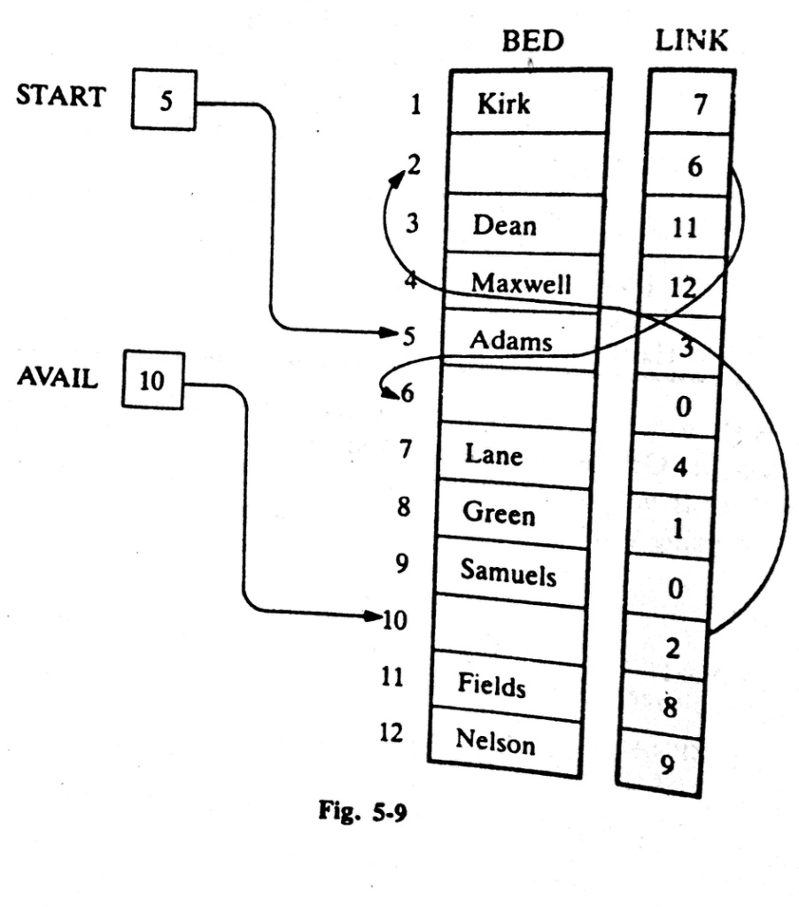
LINKED LISTS: Example 5.10

Slide 26
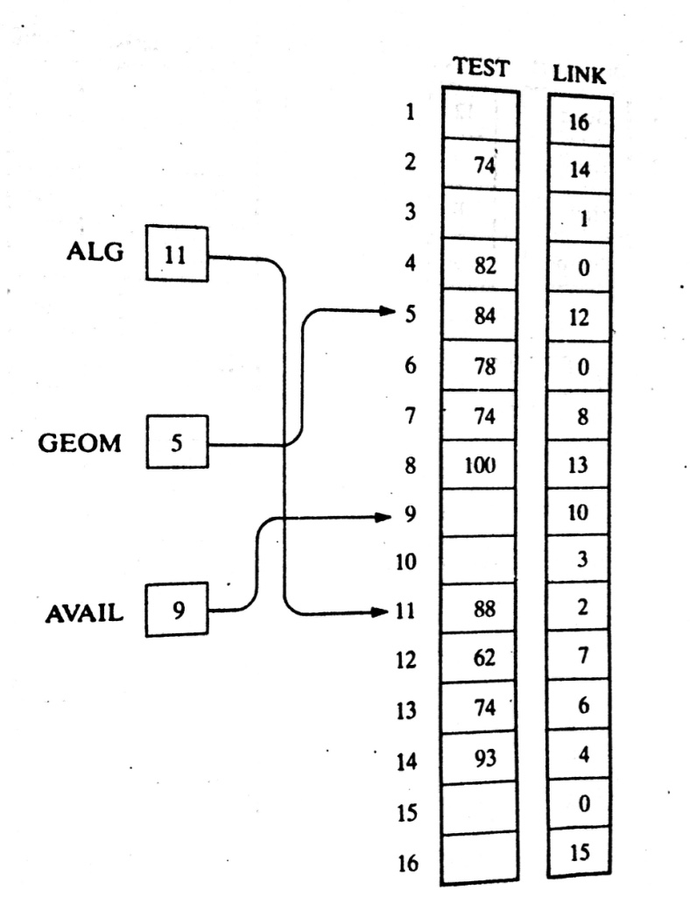
LINKED LISTS: Example 5.11(a)

Slide 27
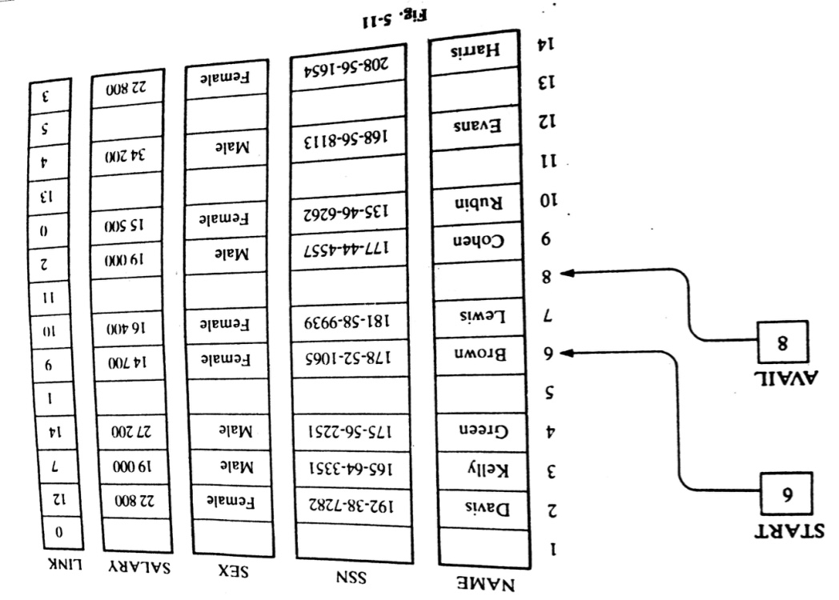
LINKED LISTS: Example 5.11(b)

Slide 28
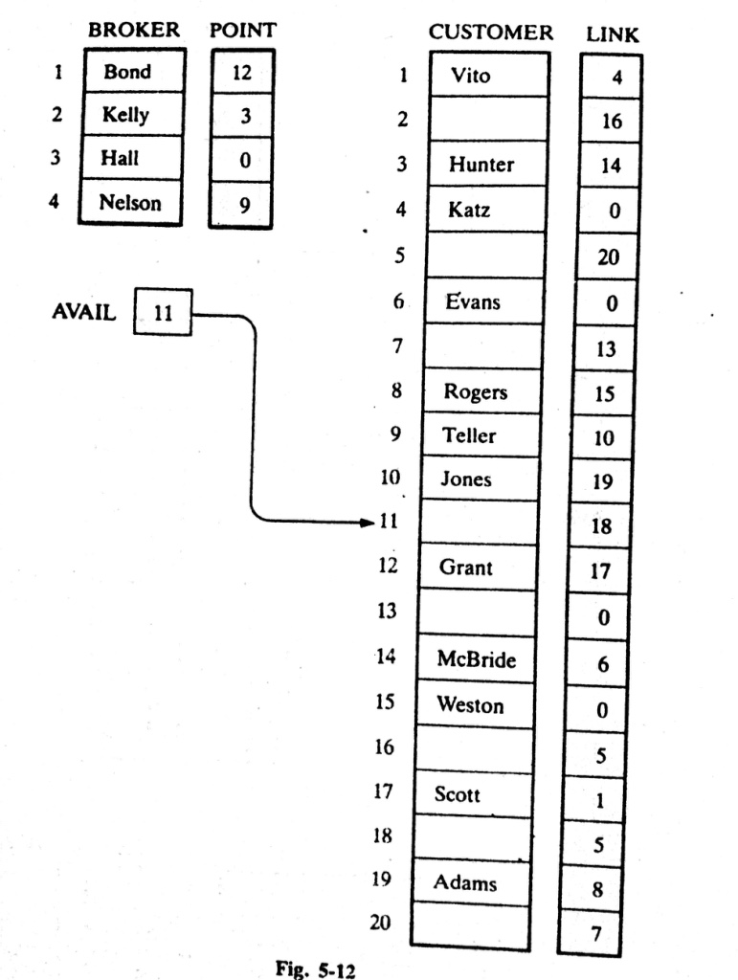
LINKED LISTS: Example 5.11(c)

Slide 29
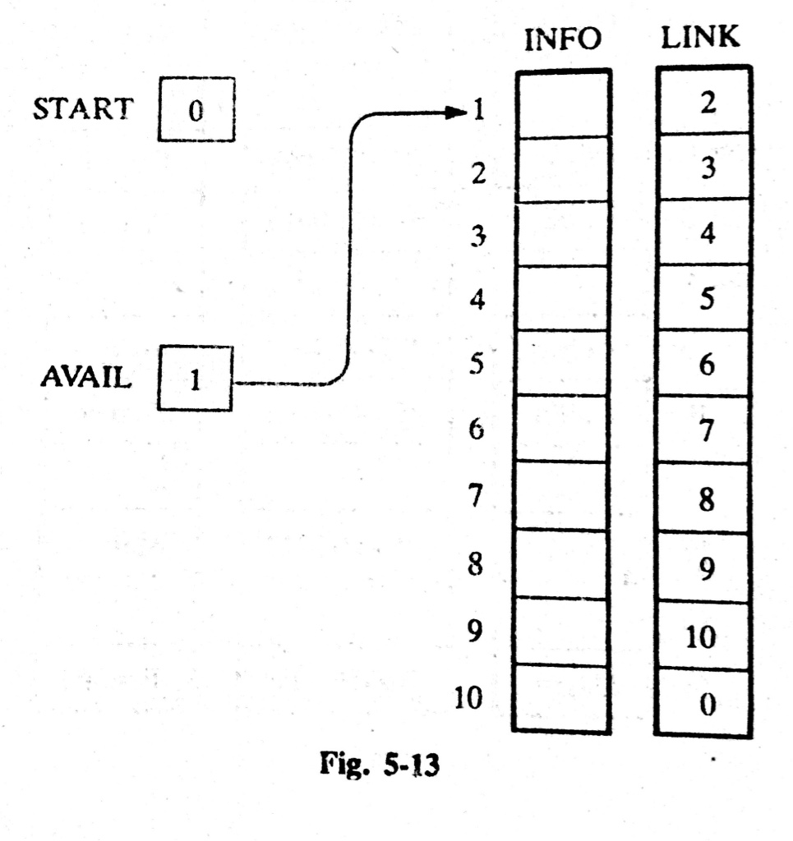
LINKED LISTS: Example 5.12
Suppose LIST(INFO, LINK, START, AVAIL) has memory space for n=5 nodes,
Furthermore, suppose LIST is initially empty.
Your INSTATNT Task
Show the LINKED LIST which consists of START, AVAIL, INFO, LINK

Slide 30
LINKED LISTS: Garbage Collection
Time Consuming Method for OS:
Time Efficient Method for OS:
The OS of a computer may periodically collect all the deleted space onto the free-space list. Any technique which does this collection is called garbage collection.
Garbage Collection usually takes place in TWO steps:
Firstly, the Computer runs through the memory, tagging those cells which are currently in use, and
Then, computer runs through the memory, collecting all untagged space onto the free-storage list.

Slide 31
LINKED LISTS: Garbage Collection
When garbage collection task executed by Computer?
The garbage collection may take place when …....
There is only some minimum amount of space in the free-storage list, or
There is no space at all left in the free-storage list, or
When the CPU is idle and has no time to do the collection
The garbage collection is invisible to the programmer

Slide 32
LINKED LISTS: Overflow
Sometimes new data are to be inserted into a data structure but there is no available space (the free-storage list is empty).
This situation is usually called Overflow.
Usually, Overflow will occur with our linked list when AVAIL=NULL and there is an insertion.
How we can handle Overflow situation?
We may handle the Overflow situation by….......
Printing the message OVERFLOW
We may modify the program by adding space to the underlying arrays

Slide 33
LINKED LISTS: Underflow
Sometime someone wants to delete data from a data structure where the data structure is empty. This situation is usually called Underflow.
Usually, underflow will occur with our linked lists when START=NULL and there is a deletion.
How we can handle Underflow situation?
We may handle the Overflow situation by….......
Printing the message UNDERFLOW

Slide 34
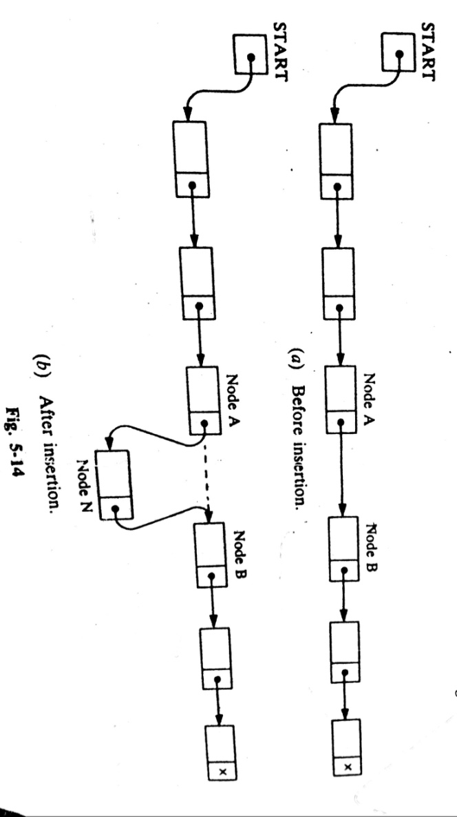
LINKED LISTS: Insertion
Let LIST be a linked list with successive nodes A and B. Suppose, a node N is to be inserted into the list between nodes A and B.
Here, it does not take into account the memory space for the new node N will come from the AVAIL list.
But…..for easier processing, the first node in the AVAIL will be used for the new node N.

Slide 35
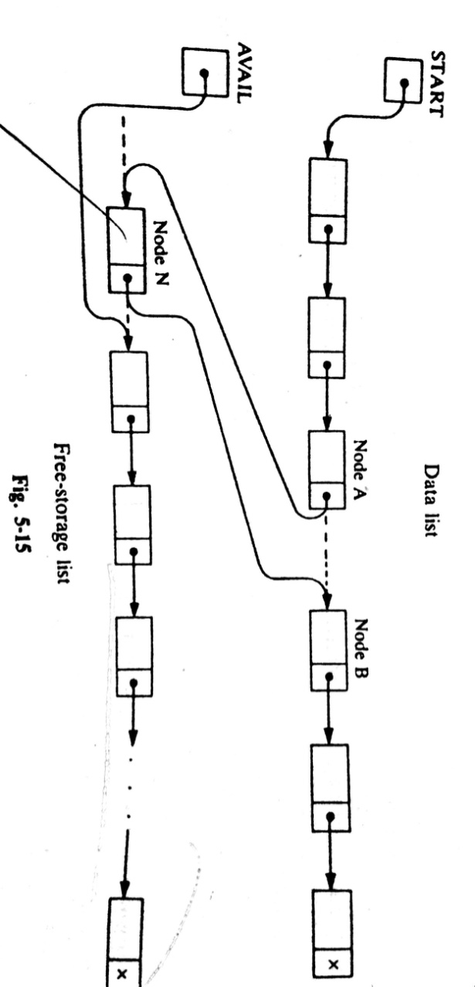
LINKED LISTS: Insertion
More exact Illustration of such an insertion
Here, THREE pointer fields are changed: ???
Which are?
The nextpointer field of node A now points to the new node N.
AVAIL now points to the second node in the free pool.
The nextpointer field of node N now point to node B.

Slide 36
LINKED LISTS: Insertion
There are also TWO special cases:
If the new node N is the first node in the list, then START will point to N, and
If the new node is the last node in the list, then N will contain the null pointer.

Slide 37
LINKED LISTS: Insertion Algorithms
Algorithms which inserts nodes into linked lists come up in various situations :
Inserts a node at the beginning of the list,
Inserts a node after the node with a given location, and
Inserts a node into a sorted list.
All the algorithms:
assume that linked list is in memory in the form
LIST(INFO, LINK, START, AVAIL)
Have a variable ITEM which contains the new information to be added to the list.

Slide 38
LINKED LISTS: Insertion Algorithms
Since all the insertion algorithm will use a node in the AVAIL list, all of the algorithm will include the following steps:
Checking to see if space is available in the AVAIL list. If not, that is,
If AVAIL=NULL, then the algorithm will print the message
OVERFLOW.
Removing the first node from the AVAIL list. Using the variable NEW to keep track of the location of the new node.
NEW:=AVAIL, AVAIL:=LINK[AVAIL]
Copying new information into the new node. i.e.,
INFO[NEW]=ITEM

Slide 39
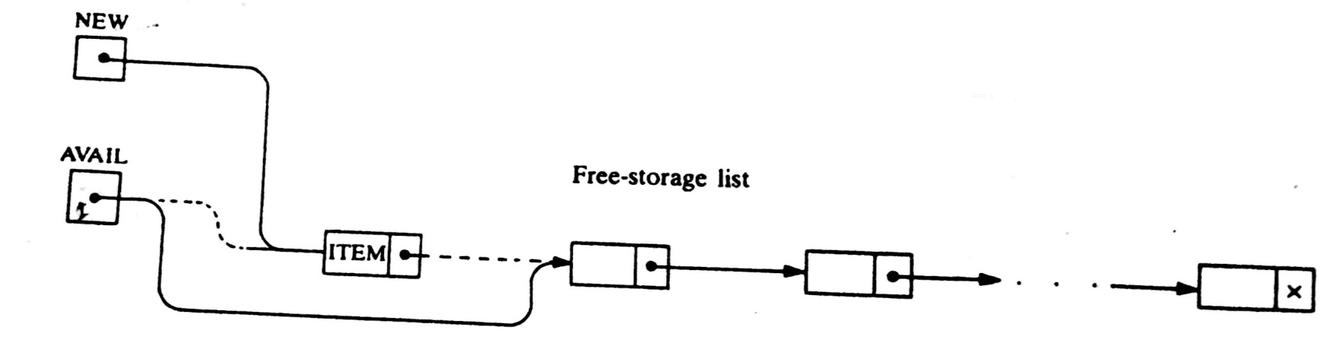
LINKED LISTS: Insertion Algorithms

Slide 40
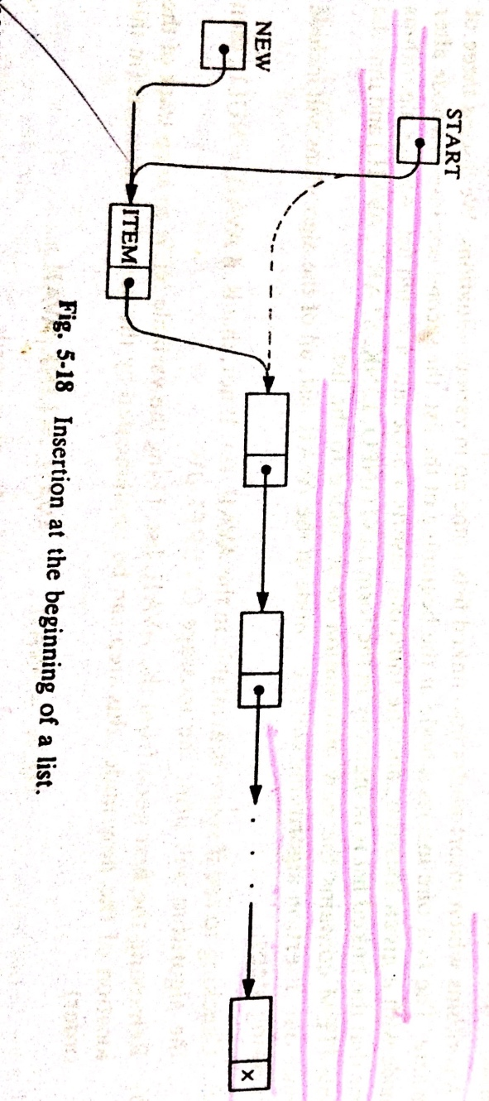
LINKED LISTS: Inserting at the Beginning of a list
[Remove first node from AVAIL list.]
Set NEW:=AVAIL and AVAIL:=LINK[AVAIL]

Slide 41
LINKED LISTS: Inserting at the Beginning ….ALG
INSFIRST (INFO, LINK, START, AVAIL,ITEM)
[OVERFLOW?] If AVAIL=NULL, then Write: OVERFLOW, and Exit.
[Remove first node from AVAIL list.]
Set NEW:=AVAIL and AVAIL:=LINK[AVAIL]
Set INFO[NEW]:=ITEM.[Copies new data into new node.]
Set LINK[NEW]:=START.[New Node now points to original first node.]
Set START:=NEW. [Change START so it points to the new node.]
Exit.

Slide 42
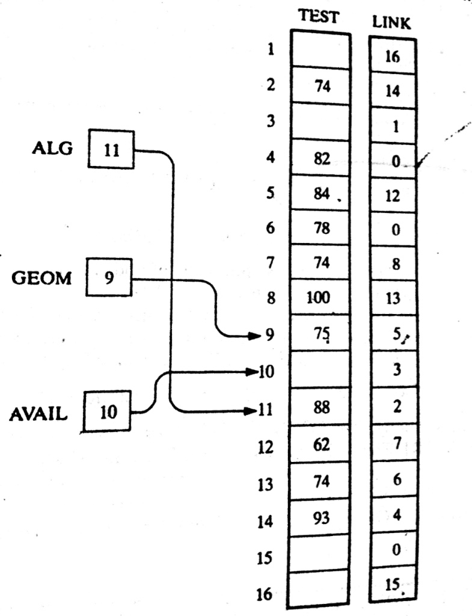
LINKED LISTS: Inserting at the Beginning ….Exmp

Slide 43
LINKED LISTS: Inserting after a given node
INSLOC (INFO, LINK, START, AVAIL, LOC, ITEM)
[OVERFLOW?] If AVAIL=NULL, then Write: OVERFLOW, and Exit.
[Remove first node from AVAIL list.]
Set NEW:=AVAIL and AVAIL:=LINK[AVAIL]
Set INFO[NEW]:=ITEM.[Copies new data into new node.]
If LOC=NULL, then [Insert as first node.]
Set LINK[NEW]:=START and START:=NEW.
Else: [Insert after node with location LOC.]
Set LINK[NEW]:=LINK[LOC] and LINK[LOC]:=NEW.
[END if If structure.]
Exit.

Slide 44
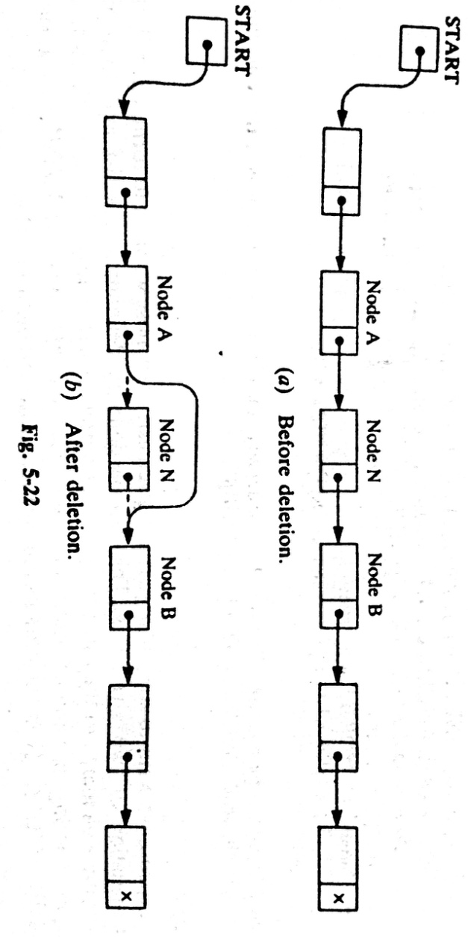
LINKED LISTS: Deletion from a Linked List
Let LIST be a linked list with a node N between nodes A and B.
Here we don’t care about the future of the deleted nodes of the linked list

Slide 45
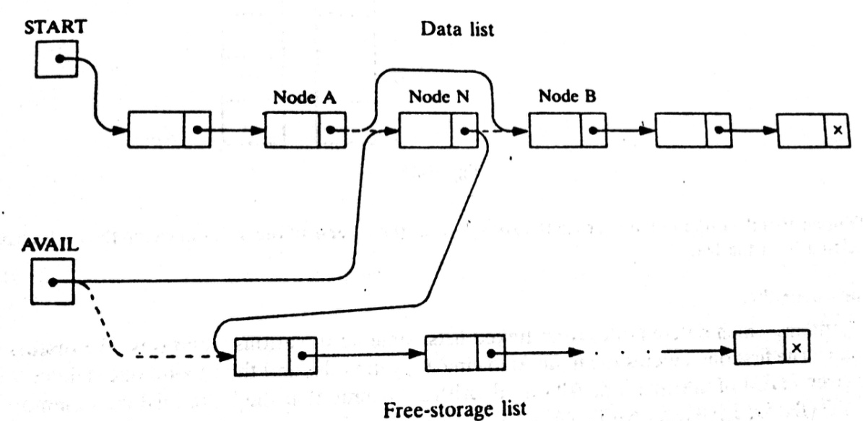
LINKED LISTS: Deletion from a Linked List
More Exact procedure:
Three pointer fields are changed:
The nextpointer field of node A now points to node B.
The nextpointer field of N now points to the original first node in the free pool.
AVAIL now points to the deleted node N.

Slide 46
LINKED LISTS: Deletion from a Linked List
There are also TWO special cases:
If the deleted node N is the first node in the list
START will point to the node B
If the deleted node N is the last node in the list
Node A will contain the NULL pointer

Slide 47
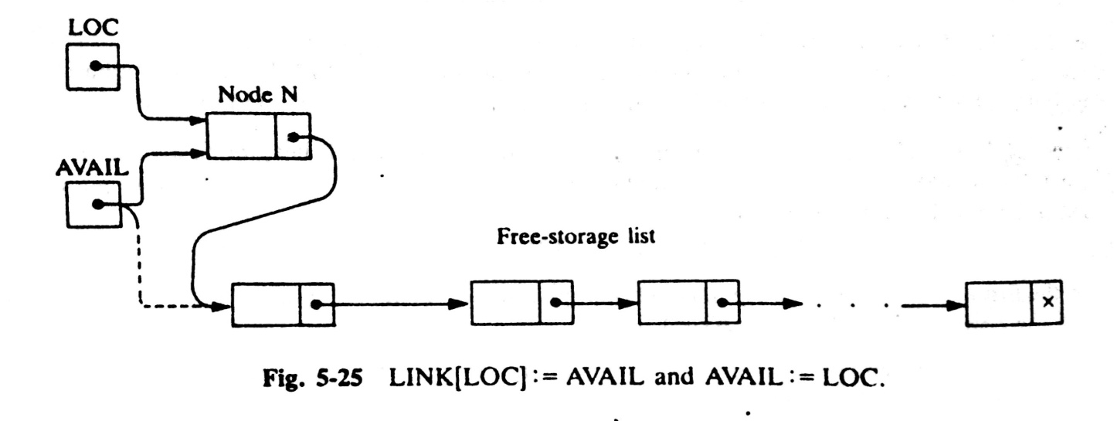
LINKED LISTS: Deletion Algorithms
Algorithms which delete nodes from linked lists come up in various situations:
The first one deletes the node following a given node, and
The second one deletes the node with a given ITEM of information
All algorithms assume that linked list is in memory in the form
LIST(INFO, LINK, START, AVAIL)
All the algorithms will return the memory space of the deleted node N to the beginning of the AVAIL list.

Slide 48
LINKED LISTS:
All algorithms will include the following pair of assignments where
LOC is the location of the deleted node N:
LINK[LOC]:=AVAIL and then AVAIL:=LOC

Slide 49
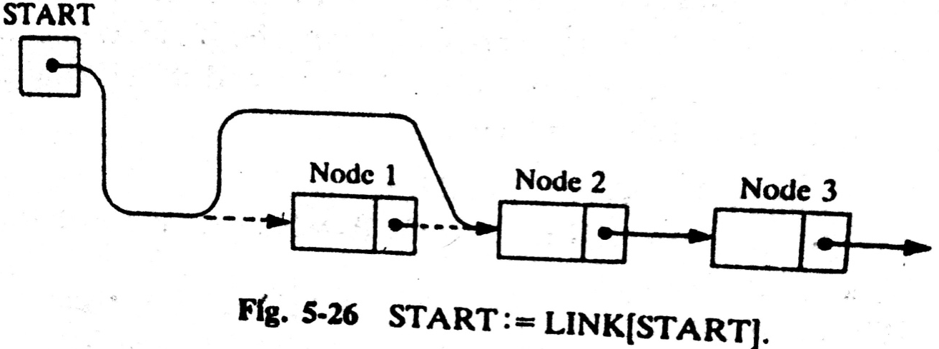
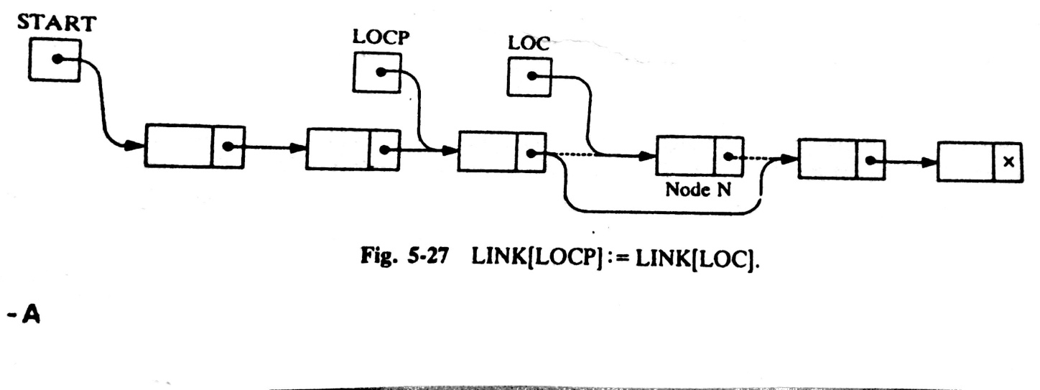
LINKED LISTS: Deleting the node following a Given Node
DEL(INFO, LINK, START, AVAIL, LOC, LOCP)
(it deletes the node N with location LOC, LOCP is the location of the node which precedes N)
Step 1. If LOCP=NULL, then:
Set START:=LINK[START]. [Delete first node.]
Else:
Set LINK[LOCP]:=LINK[LOC]. [Deletes node N.]
[End of If structure]
Step 2. [Return deleted node to the AVAIL list.]
Set LINK[LOC]:=AVAIL and AVAIL:=LOC.
Step 3. Exit.

Slide 50
LINKED LISTS: Deleting the node with a given ITEM
Let LIST be a linked list in memory.
Suppose we are given an ITEM of Information and we want to delete from the LIST the first node which contain ITEM.
The algorithm has TWO PARTS
First we give a procedure which finds the location LOC of the node N containing ITEM, and the location LOCP of the node preceding node N.
If N is the first node with ITEM, we set LOCP=NULL
If ITEM does not appear in LIST, we set LOC=NULL
Traverse the list, using pointer variable PTR and comparing ITEM with INFO[PTR]at each node.
While track the location of the preceding node by using a pointer variable SAVE. Thus
SAVE:= PTR and PTR:= LINK[PTR]

